Slide 1
Introducing FIPLV
Prof. Terry Lamb, President of FIPLV
AssIt2023

Slide 2

FIPLV
A Federation of multilingual and monolingual, international and national language teacher associations
Founded in Paris in 1931
NGO of UNESCO and the Council of Europe

Slide 3
Structure of FIPLV
Executive Committee
Honorary Counsellors
Members ➔ World Assembly

Slide 4
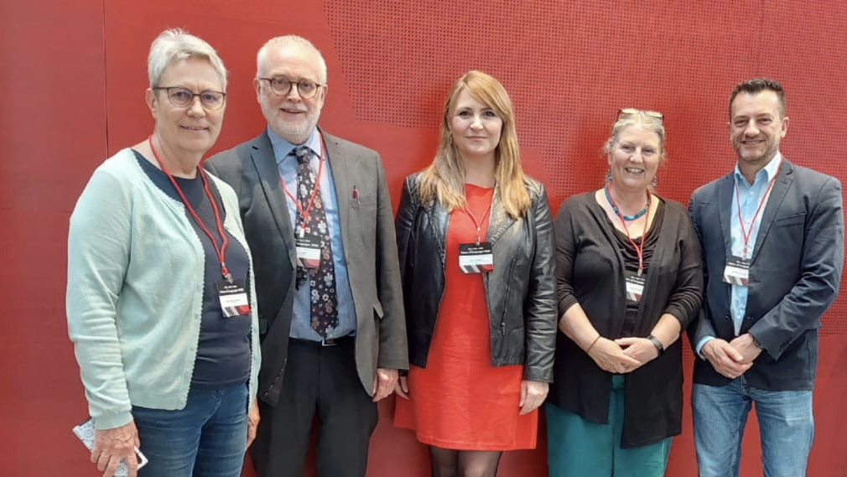
President
Vice President
Publications Officer
Secretary-General
Treasurer-General

Slide 5
Structure of FIPLV
Executive Committee with 5 elected Officers
  President: Terry Lamb (UK)
  Vice President: Sigurborg Jónsdóttir (Iceland)
  Secretary-General: Geraldo de Carvalho (Brazil)
  Treasurer-General: Judith Richters (Netherlands)
  Publications Officer: Sylvia Velikova (Bulgaria)
Honorary Counsellors
Members ➔ World Assembly

Slide 6
FIPLV Members
3 FIPLV Regions: Nordic-Baltic, Central/Eastern Europe, Western Europe
4 international monolingual associations: English, Esperanto, German, Russian
22 national multilingual associations: ACTFL (USA), ALL (Great Britain), ANILS (Italy), LEVENDE TALEN (Netherlands), STIL (Iceland), LEVENDE TALEN (Netherlands), SAALT (South Africa), SUKOL (Finland), etc.
5 national monolingual associations: BETA, ASOCOPI, AIPLF, etc.
Associate members

Slide 7
What we do
World Assembly
World Congress ➔ Auckland, 6-9 July 2024
Regional Conferences ➔ NBR Conference in Reykjavik, June 2023
FIPLV International Award ➔ BETA, MANYE, ÖDaF, SUKOL (2022)

Slide 8
What we do
Projects with the European Centre for Modern Languages of the Council of Europe (ECML)
Notes:
Location, PNF

Slide 9

Notes:
Mention who was on team

Slide 10


Slide 11


Slide 12
What we do
Projects with the European Centre for Modern Languages of the Council of Europe (ECML)
Supporting regional and other projects, including research
Promoting and supporting multilingualism
Advising on language policy

Slide 13
Strategic Plan 2023-2024
  Developing collaborations between language teacher associations in Latin and South America
  Developing sponsorship
  Publications: Newsletter, Handbook
  Surveys, Webinars, Website

Slide 14
  Grazie!
  Thank you!
  fiplv.com

